Slide 1

Unlocking trapped data with AWS
Booz Allen Tech Ed Excellence – Cloud Engineering Project
October 28 2020

Slide 2
agenda
Project overview
Business challenge
Serverless architecture
Demo (live/recorded)
Business outcomes and learning
Future roadmap
Speedbumps
Appendix – costs summary

Slide 3



Project overview
Team members:
Jyoti Wadhwa
Jeffery McCracken
Zander Lanfried
Michael Lynch
Design and development process:
Concept of Operations Design
Implement Streamlined Process to Query DynamoDB from Rest API
Add Additional API Features
PHASE 1
PHASE 2
PHASE 3

Slide 4

business challenge and Project concept
Phase 1
Driving Business Scenario and Application vision
Situation
An internal Booz Allen account was central to coordinating responses among the staff tracking and managing the challenges of COVID-19.
Sub-accounts and functional teams needed to partner to collect and provide information to the matrixed team members that were rapidly responding to the evolving COVID environment.
Challenge
Multiple data stores lacking enterprise-wide Integration for tracking staff made information was not easily accessible and centrally available.
Solution
The need for an efficient and streamlined approach for accessing and viewing real-time data from internal sources, such as Workday was clear! This business challenge drove our focus on developing a capability to easily and dynamically query data via a serverless architecture.
Application Vision
Data-based intelligence and decisions
Transformative and modernized process for real-time, broad queries
Storage (Highly Available and Accessible
Data Source (i.e. Workday, Data table)
Solution was to leverage cloud or serverless technologies to modernize our current manual business processes to transform the data from multiple sources to be easily digested by stakeholders.
Level 6 is a footnote or a place for source information.
Notes:
An internal Booz Allen account was central to coordinating responses among the staff tracking and managing the challenges of COVID-19.
Sub-accounts and functional teams needed to partner to collect and provide information to the matrixed team members that were rapidly responding to the evolving COVID environment.
Challenge: multiple data stores lacking enterprise-wide Integration for tracking staff made information was not easily accessible and centrally available.
The need for an efficient and streamlined approach for accessing and viewing real-time data from internal sources, such as Workday was clear. This business challenge drove our decision to focus on developing a capability to easily and dynamically query data via a serverless architecture.
Solution was to leverage cloud or server-less technologies to modernize our current(manual) business processes to transform the data from multiple sources to be easily digested by stakeholders.

Slide 5
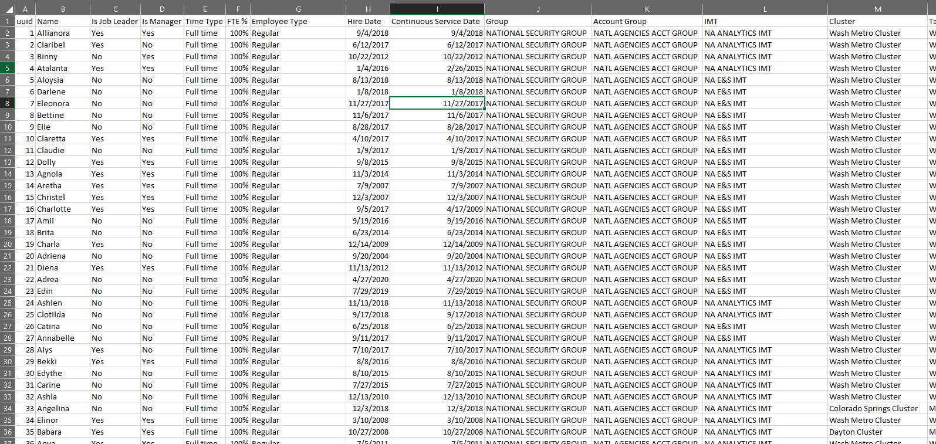
Phase 1: Project concept
Phase 1
Data table
Original Source: Workday
Level 6 is a footnote or a place for source information.

Slide 6




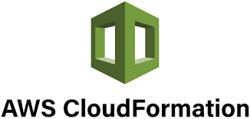

Part 1: CloudFormation builds resources
Phase 2
1
Foundational resource build leveraging AWS CloudFormation
AWS Lambda
Lambda automatically updates and loads new data as it is uploaded into S3
Employee Data (.CSV)
AWS S3
AWS DynamoDB
AWS CloudFormation
Notes:
Leveraged Cloudformation from github template to automatically spin up a handful of AWS resources: a DynamoDB Table, S3 bucket, and lambda function. High level the way this process works is the user will upload the employee data csv file into the S3 bucket hosted on AWS. Once this file is uploaded, a lambda function is triggered which copies and transforms the data into AWS’s managed NoSQL database, DynamoDB. From here the data can be queried from within AWS by the user, but in the next section Zander will discuss how we made the data accessible over the internet via an API.

Slide 7
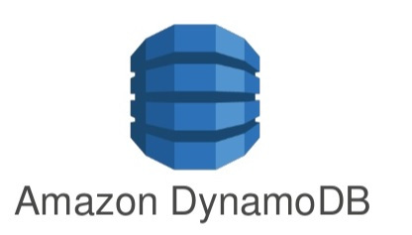


Part 2: Enabling api access to dynamodb using lambda
Phase 3
1
Automatically update and load new data as it is uploaded into S3
Employee Data (.CSV)
Transformative process
Infrastructure as code
Automation
AWS Services
Provide multiple query methods and secure access using API keys
2
Enable API to query DynamoDB
3
Project Tools Summary: Workday, .CSV, CLI, AWS (CloudFormation, S3, Lambda, DynamoDB, API Gateway, API Key. Management Console, Cost Explorer), GitHub, Webex, MS Teams, Zoom)
Notes:
Zander – step 2 notes
adding the API

Slide 8
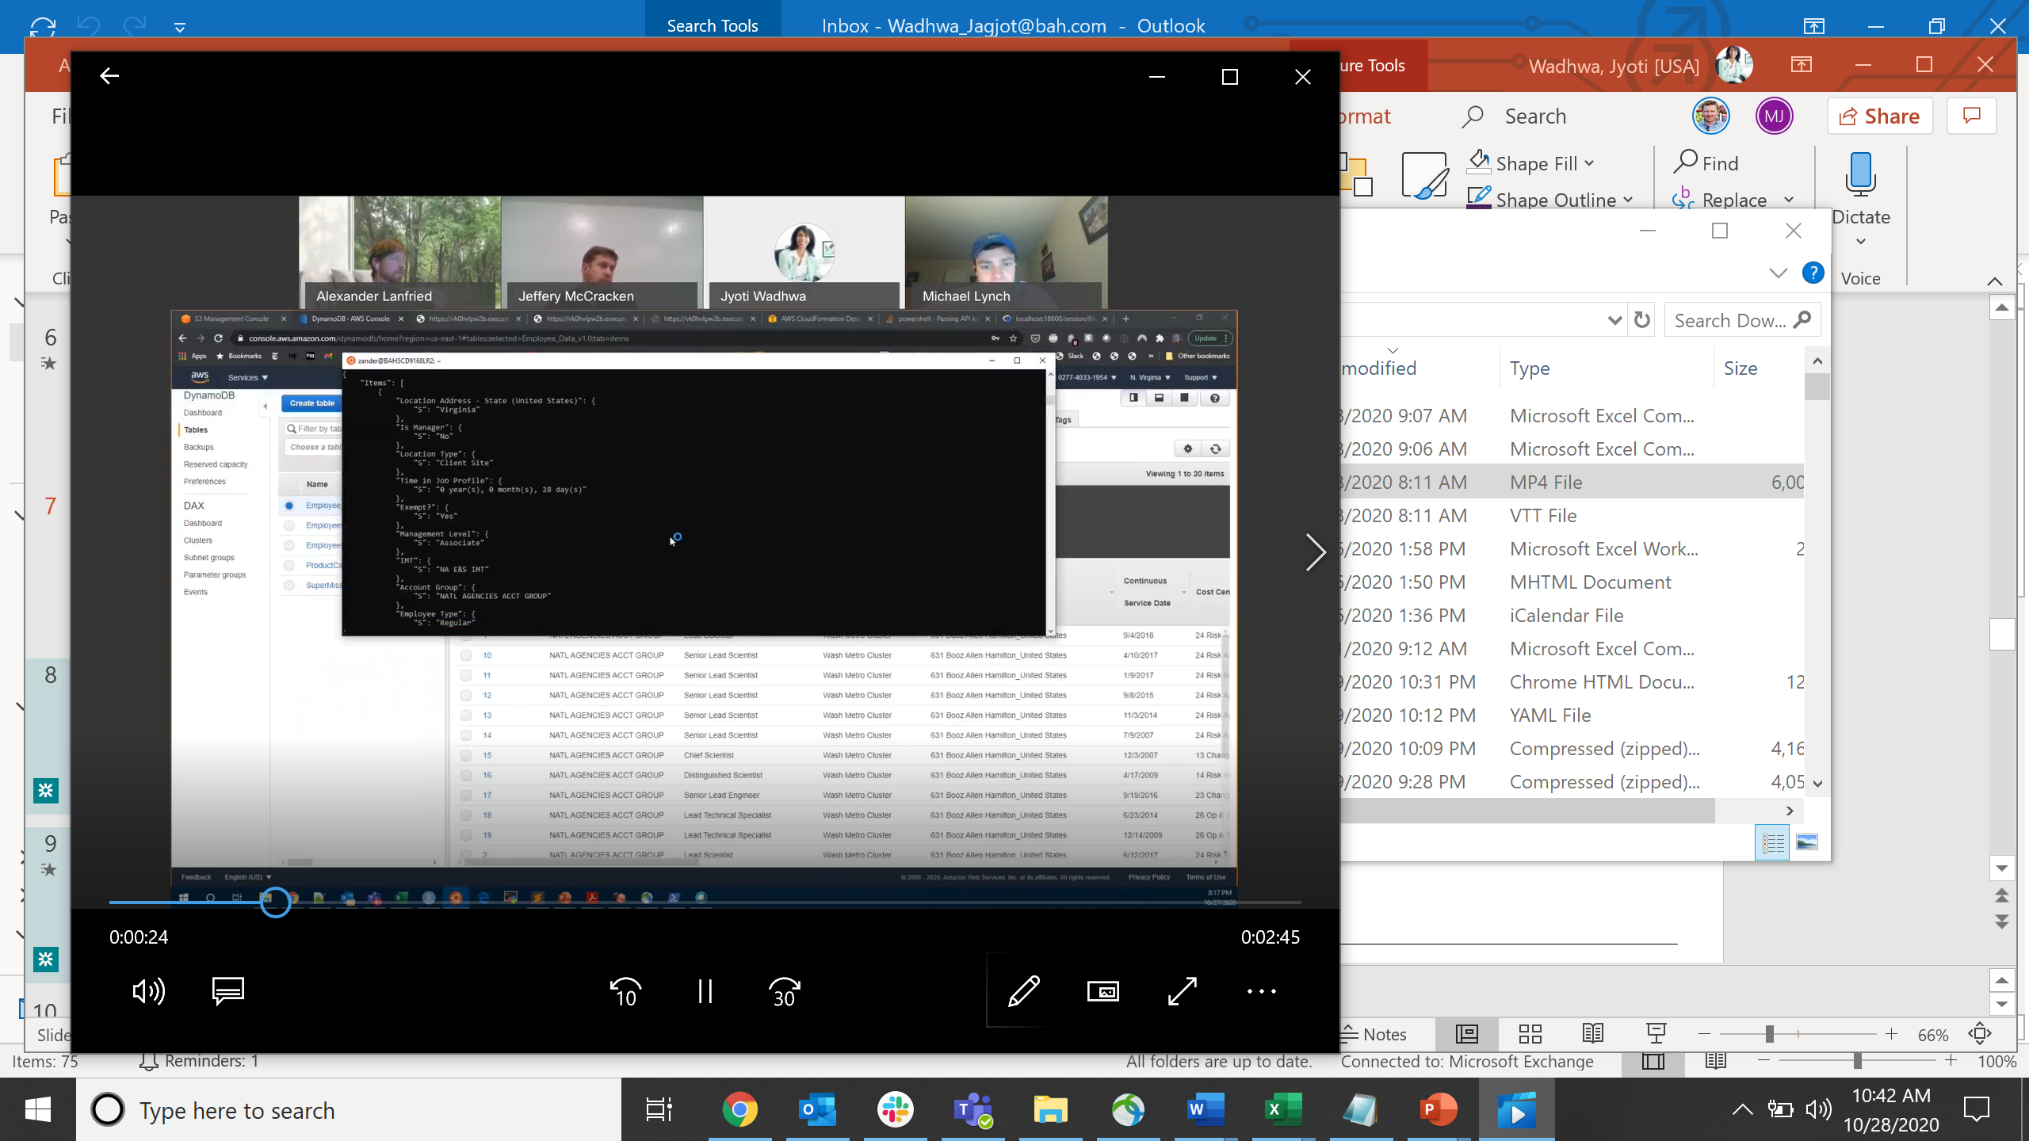
Project demonstration
Serverless Database & Query Demo
Notes:
Demo Steps
Start dydb in consolue
Qury via API
Only first 20 users (2 queries mgmt. level)
New file append
Additional query
Show API Key

Slide 9
Operational advantages and learnings
Serverless Application
Highly Scalable
Cost effective → $1.68-.51 (C9)
REST API Provides Extensibility
Enables easy addition of new features
Example: business functionality, security and user-friendly
NoSQL Database
Enables easy and efficient queries of large data sets that were previously disaggregated and locked in spreadsheets
Enhanced Security
Leverages native AWS hardware/infrastructure for seamless security
AWS API keys ensure end-user authentication for each query

Slide 10


Future Roadmp Features
Potential Areas of Expansion
Add a user-friendly web page to upload files to S3
Replicate in another AZ/Region and provide failover for resiliency
Employee Data (.CSV)
Enable API to query DynamoDB
Add front-end application for user-friendly query
Notes:
Zander – step 2 notes
adding the API

Slide 11
speed bumps along the way
No. | Issue | Description
1 | Team members had trouble viewing the viewing the tables being created | Users were in different regions to create tables, Different account number being used
2 | Trouble creating the table via the CLI | The table was stopping at only taking the first 25 records via the CLI
3 | Public queries not retrieving the employee data from the database | Public query from web browser hits the lambda function, but does not find the according employee ID
4 | Lambda function from Cloudformation template using UTF-1 encoding process | The original Python function embedded in the Cloudformation template within Lambda used UTF-1 text encoding, which apparently did not function well with the CSV data and would only export 100-200 entries in DynamoDB. The encoding method need to be changed to ‘latin-1’ which successfully exported all of the CSV data into the table.
5 | Cognito issues | Had issues passing the Authentication token from Cognito to the application through the header
6 | Queries not working | Understanding how to pass path parameters and query parameters to the lambda function and have it map to the DynomoDB API was challenging. Now working: Management Level value of the query and individual employee
7 | ​Creating Lambda functions | Bit of a learning curve in terms of how to test the lambda function using console log and through the API Gateway console. Somewhat challenging to debug through the API Gateway when trying to pass parameters from the URL
Project Tools Summary: Workday, .CSV, CLI, AWS (CloudFormation, S3, Lambda, DynamoDB, API Gateway, API Key. Management Console, Cost Explorer), GitHub, Webex, MS Teams, Zoom)

Slide 12
appendix

Slide 13
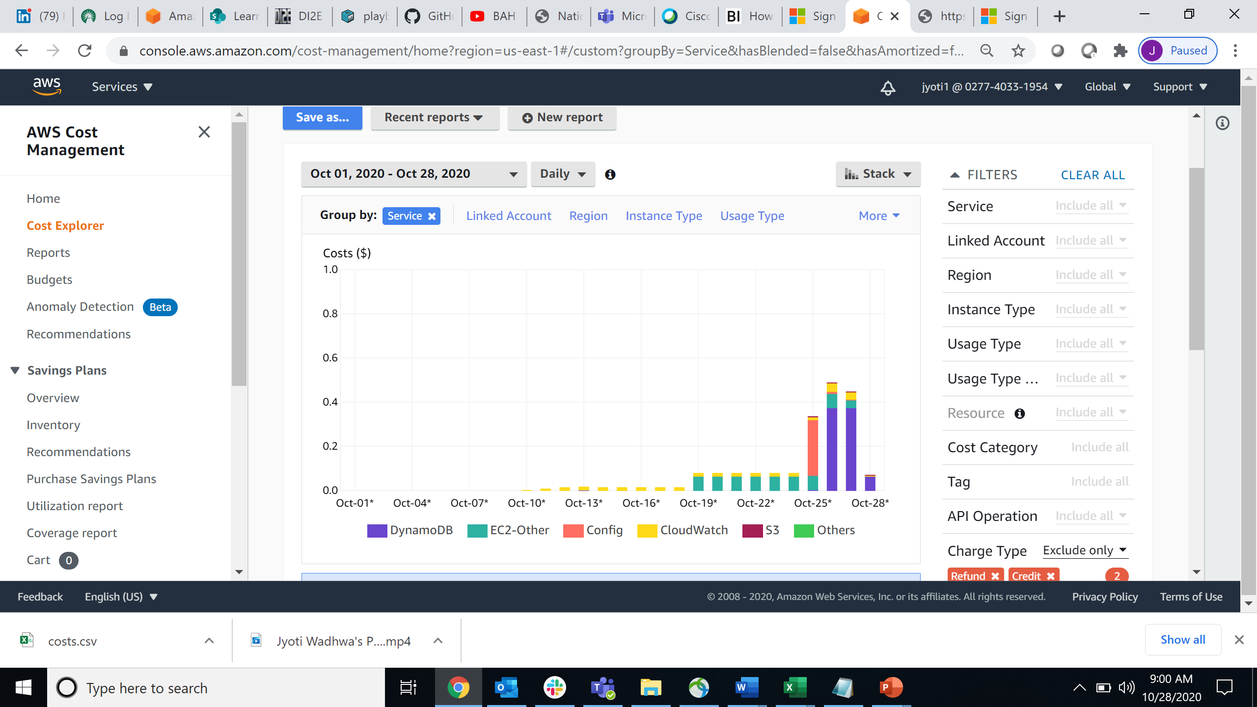
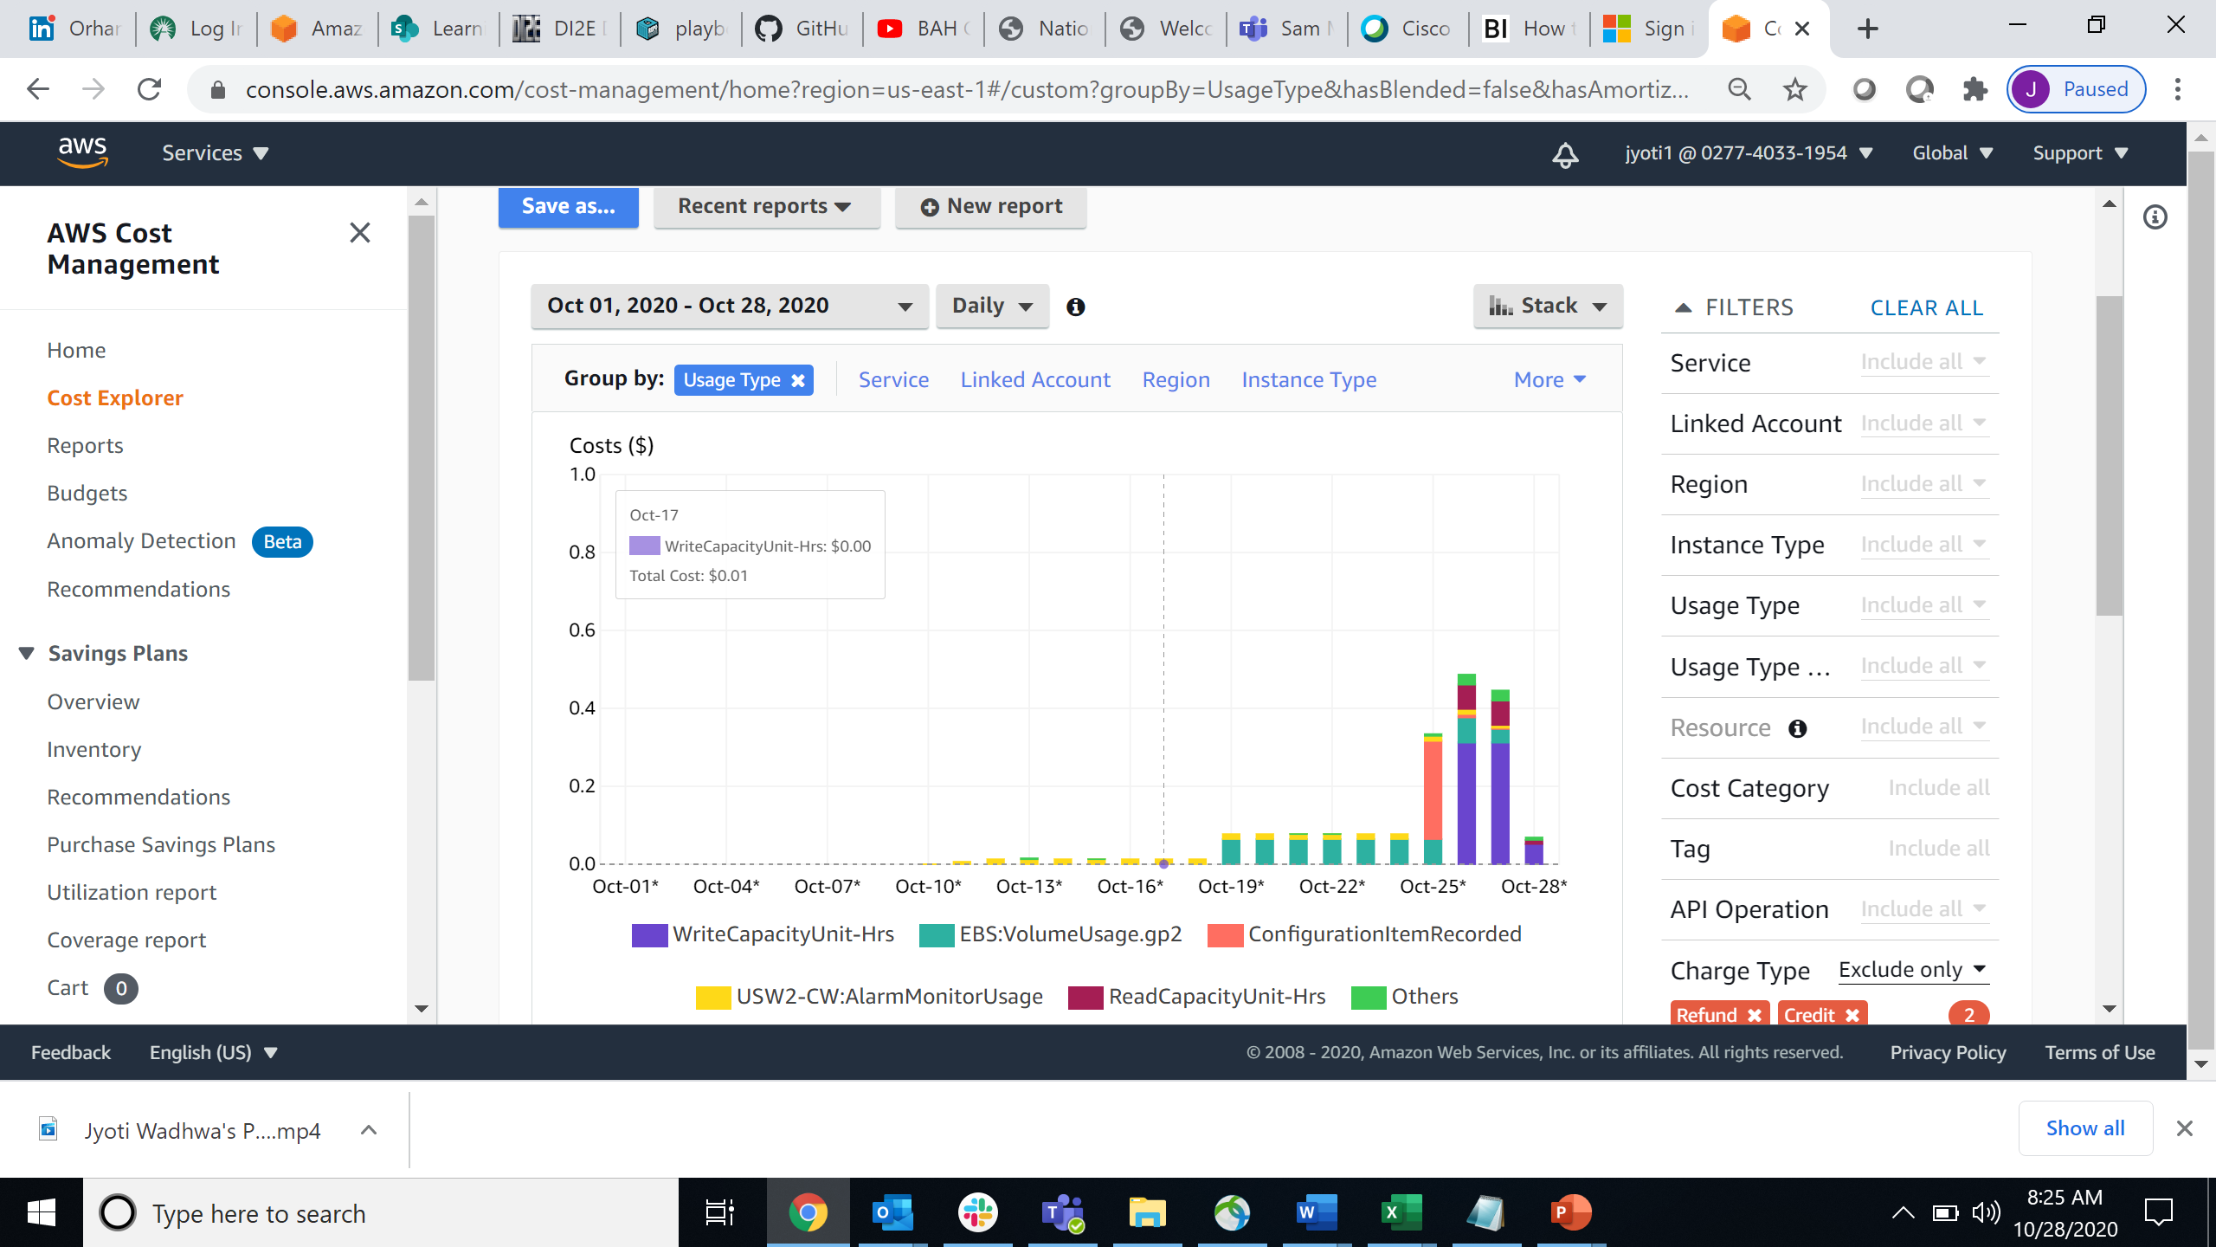
Costs summary
Service
Usage Type
Cloud 9 In-class demo
Costs Summary
Service | DynamoDB | EC2-Other | Config | CloudWatch | S3 | Tax | Key Mgmt Service | Lambda | SNS | Budgets | API Gateway | EC2-Instances | Cognito | SQS | Total cost
Total | 0.81904225 | 0.55135562 | 0.264 | 0.26339605 | 0.0015616 | 0 | 0 | 0 | 0 | 0 | 0 | 0 | 0 | 0 | 1.89935553
10/1/2020 |  |  |  |  |  | 0 |  |  |  |  |  |  |  |  | 0
10/28/2020 | 0.06446875 |  |  | 0.00430108 | 0.00003 |  | 0 | 0 |  |  | 0 |  |  |  | 0.06879983
Total(-Cloud9) | 0.81904225 |  | 0.264 | 0.26339605 | 0.0015616 | 0 | 0 | 0 | 0 | 0 | 0 | 0 | 0 | 0 | 1.3479999

